Slide 1

Drone Analysis
E. Venkata Durga Rao
P . Goutham
M. Rajesh Goud

Slide 2

Exploratory Data Analysis:
Data Cleaning Steps
1. Loaded the dataset using Pandas (576 rows × 9 columns).
2. Checked dataset structure using info(), head(), and dtypes.
3. Identified missing and inconsistent data using isnull().sum().
4. Cleaned the 'Price' column by removing commas and converting to numeric.
5. Replaced missing values using mode (categorical) and mean (numerical).
6. Dropped 'Power Consumption' column due to excessive null values.
7. Rechecked dataset to ensure all missing values were handled.
8. Prepared cleaned dataset for Data Manipulation.

Slide 3
2.Data Manipulation Steps
1. Converted 'Weight' units (kg → g) and created a new column 'Weight (g)'.
2. Converted 'Control Range' (ft→ m) converted values to meters and created a new column 'Range (m)'.
3. Removed redundant columns ('Weight', 'Control Range', 'Power Consumption').
4. Converted all numerical columns to float type.
5. Verified final dataset using info() for data types and nulls.

Slide 4
Final Outcome :
• All missing values handled appropriately.
• Data types standardized for analysis.
• Units converted for uniformity.
• Dataset ready for Exploratory Data Analysis (EDA) and visualization.
• Saved final cleaned dataset as 'Drone_Cleaned_Final.csv'.

Slide 5
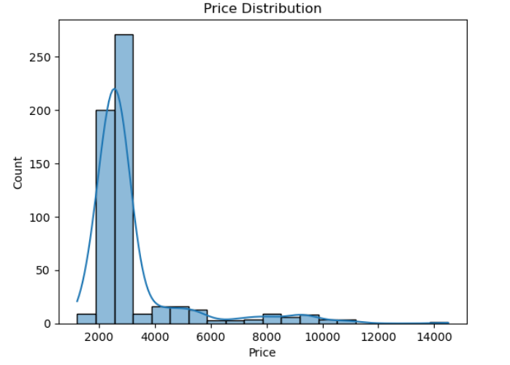
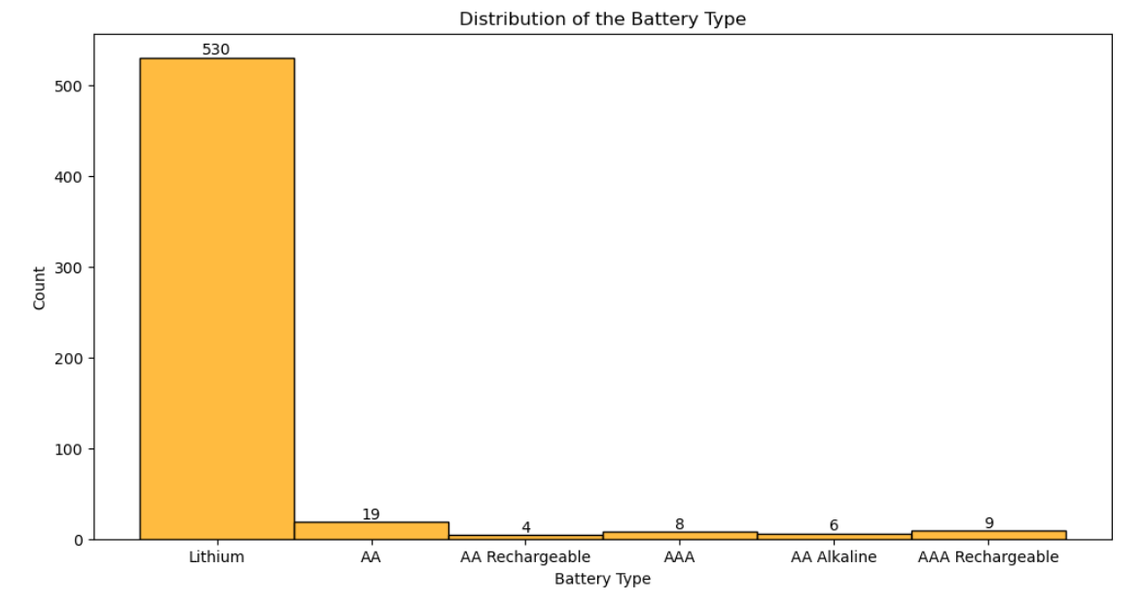
3. Univariate Analysis Steps
Price Distribution
Distribution of the Battery Types
The dataset contains 6 battery types, and among them, Lithium batteries appear the most frequently.
Most drones are priced between ₹1500–₹3000, as this range shows the highest count in the distribution.

Slide 6
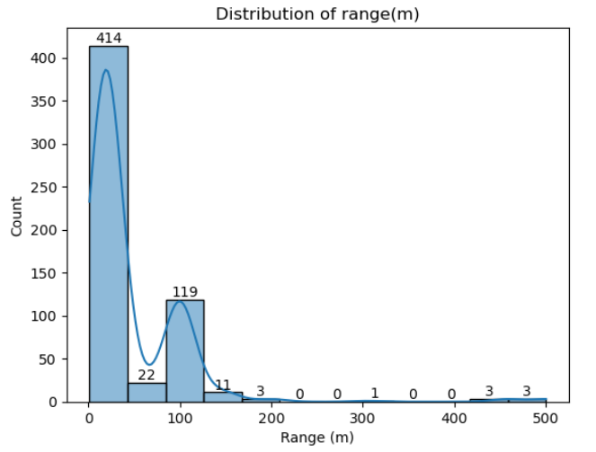
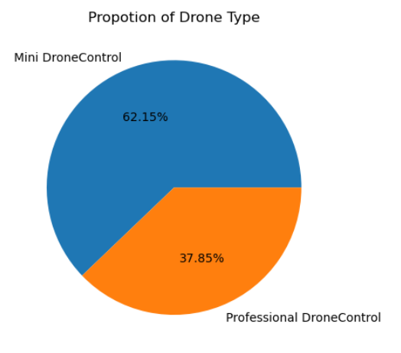
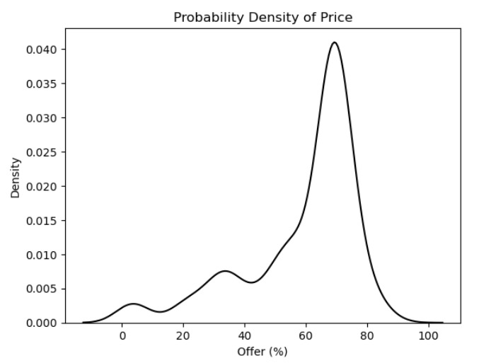
Range Distribution
Propotion of Drone Type
Probability Density of Offer
Most drones have a range below 50 m (414 counts), while only a few drones offer higher ranges above 100 m.
Mini drones have the highest (62.15), whereas professional drones are fewer (37.85) in the dataset.
Most Offers are in between 60 – 80%

Slide 7
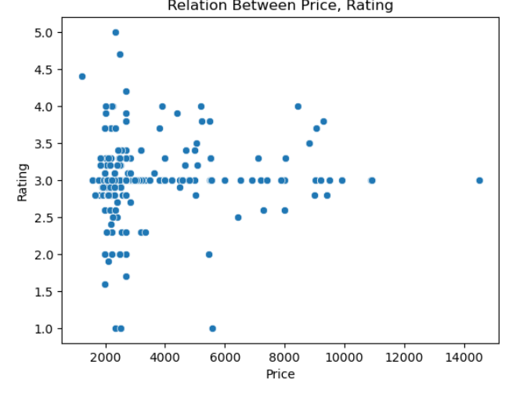
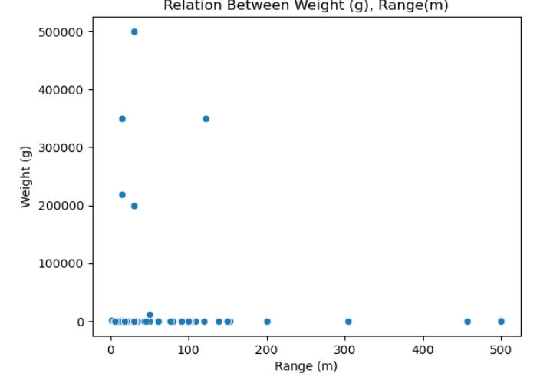
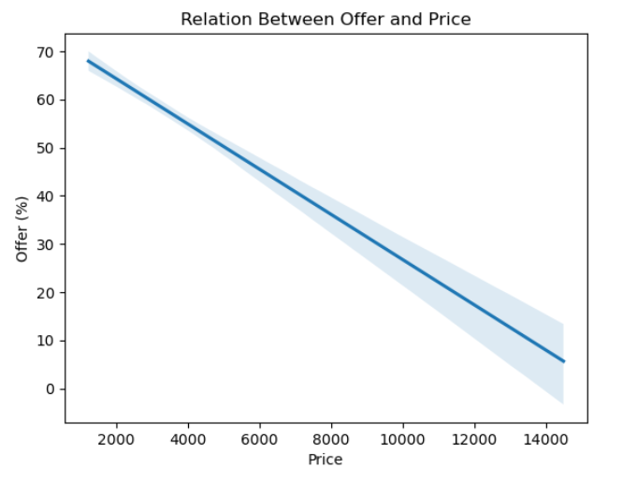
4. Bivariate Analysis Steps
Relation Between Price, Rating
Relation Between Weight (g), Range(m)
Relation Between Offer and Price
Most drones, even low-priced ones, maintain average ratings around 3–4, showing that higher price does not guarantee better ratings.
Weight and range show an inverse relationship
as the drone’s weight increases, its range tends to decrease.
Price and Offer show an inverse relationshipas the drone’s Offer increases, its Price is decrease.

Slide 8
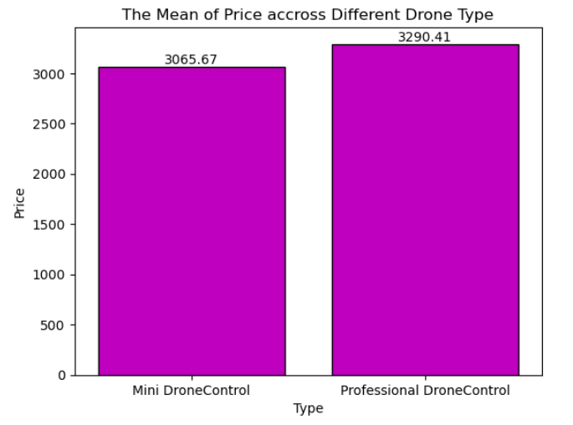
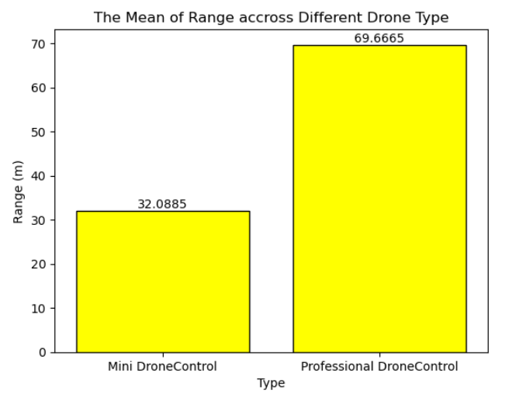
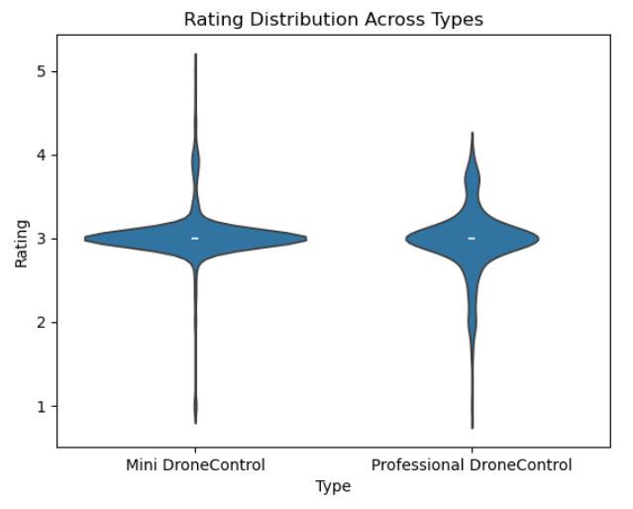
The Mean of Price accross Different Drone Type
The Mean of Range accross Different Drone Type
Rating Distribution Across Types
Mini Drone has average price (3065), Professional Drone has (3290)
Professional Drone Slightly More
Professional drones have double the range of mini drones.
Mini drones show more ratings spread; professional drones have more consistently high ratings

Slide 9
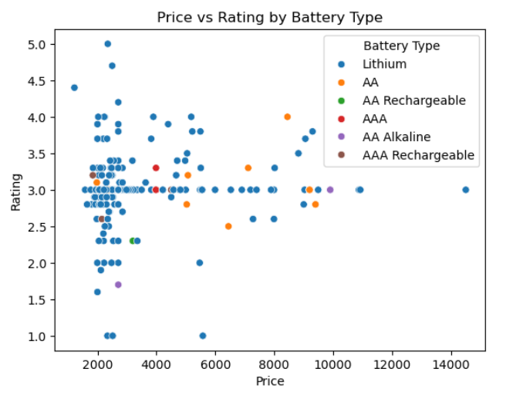
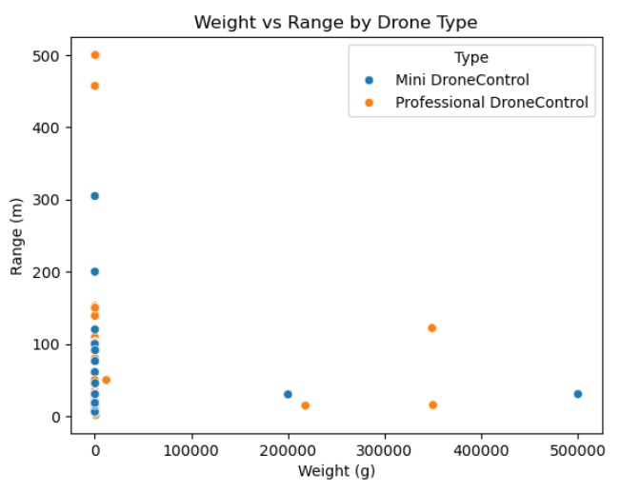
5. Multivariate Analysis Step
Price vs Rating by Drone Type
Price vs Rating by Battery Type
Most drones are light with short ranges; no clear weight-range trend.
Lithium batteries show higher ratings and cover a wide price range, while other types are mostly cheaper and less frequently rated as high. No clear price-rating trend is visible across battery types.

Slide 10
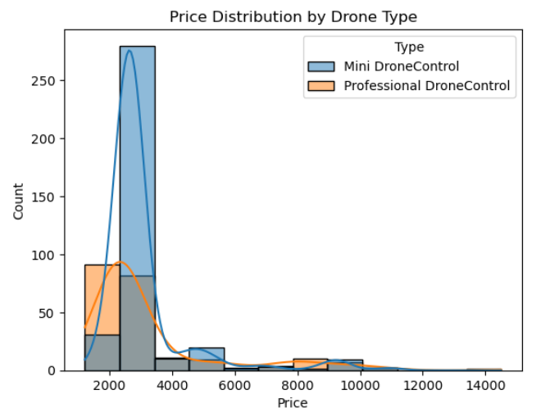
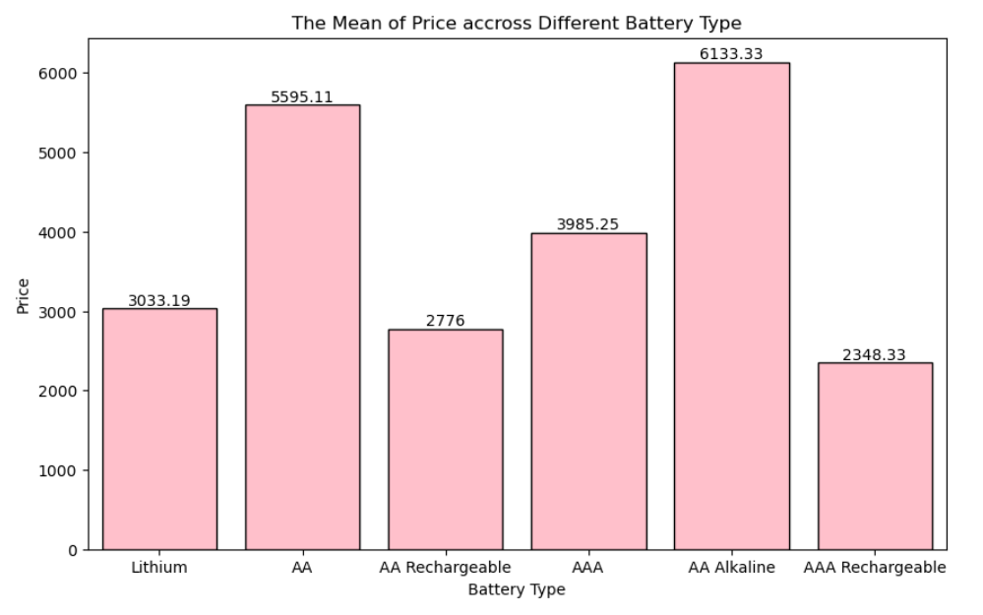
Price Distribution by Drone Type
The Mean of Price accross Different Battery Type
Most drones are priced between ₹1500–₹3000, as this range shows the highest count in the distribution.
Mini drones making up the highest count in this price range.
Drones with AAA Alkaline and AA batteries are the most expensive; AAA and AA rechargeable are the cheapest.

Slide 11
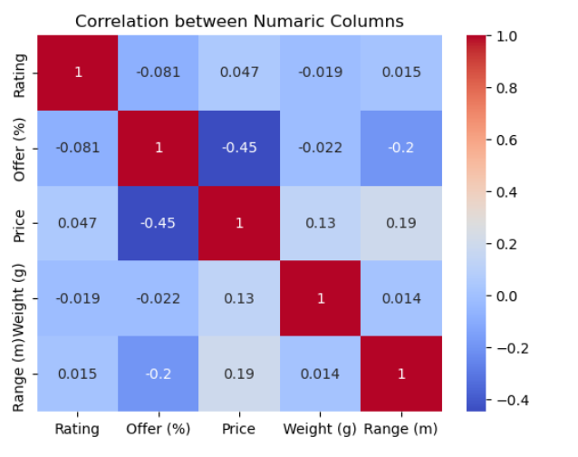
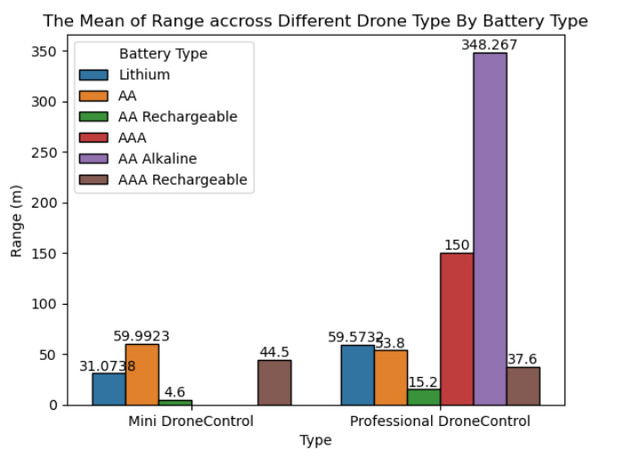
The Mean of Range accross Different Drone Type By Battery Type
Correlation between Numerical Columns
The strongest negative correlation is between price and offer percentage; higher offers tend to come with lower prices.
Professional drones with AA Alkaline batteries have the highest range by far—348 meters.

Slide 12
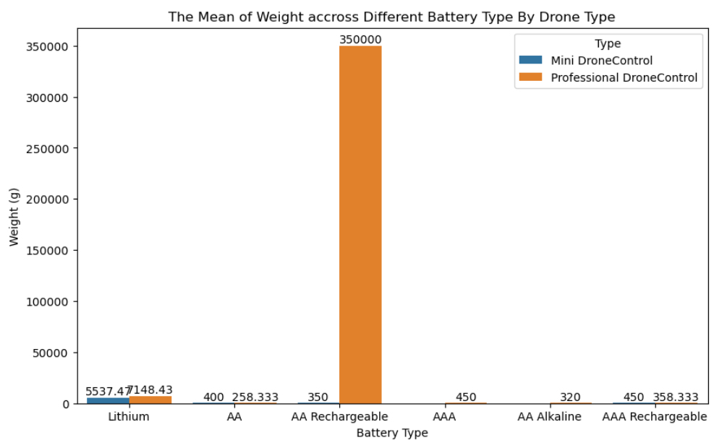
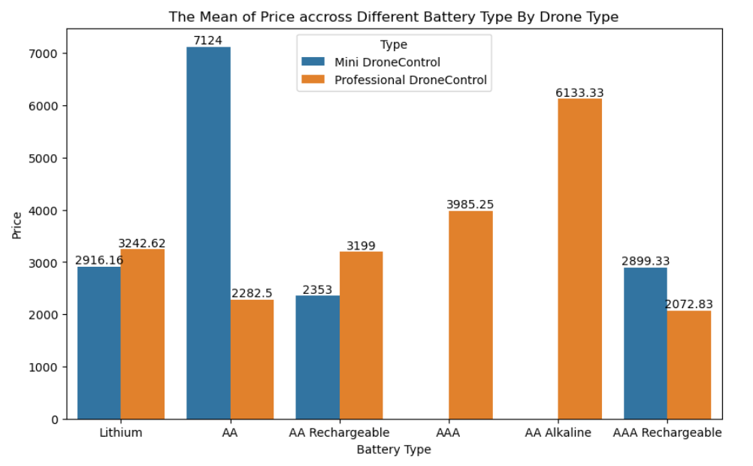
The Mean of Price accross Different Battery Type By Drone Type
The Mean of Weight accross Different Battery Type By Drone Type
Mini drones with AA batteries cost the most (₹7124); professional drones with AA Alkaline are the priciest among professionals (₹6133).
Professional drones using AA rechargeable batteries have extremely high average weight compared to all other types.

Slide 13
Summary
Battery Analysis : Lithium batteries consistently receive higher ratings compared to other battery types. The rating of batteries does not increase with price, meaning you can find both high- and low-rated batteries across different price points.
Drone Analysis : Most drones, whether mini or professional, are lightweight and have a shorter operating range. There is no strong pattern where drones with greater weight automatically have a longer range; both light and heavy drones can have short or long ranges.
the main performance indicator (rating for batteries and range for drones) does not strongly depend on the price or weight variable, showing that other factors may need to be considered when choosing products in these categories.

Slide 14

THANK YOU

